Slide 1


Slide 2
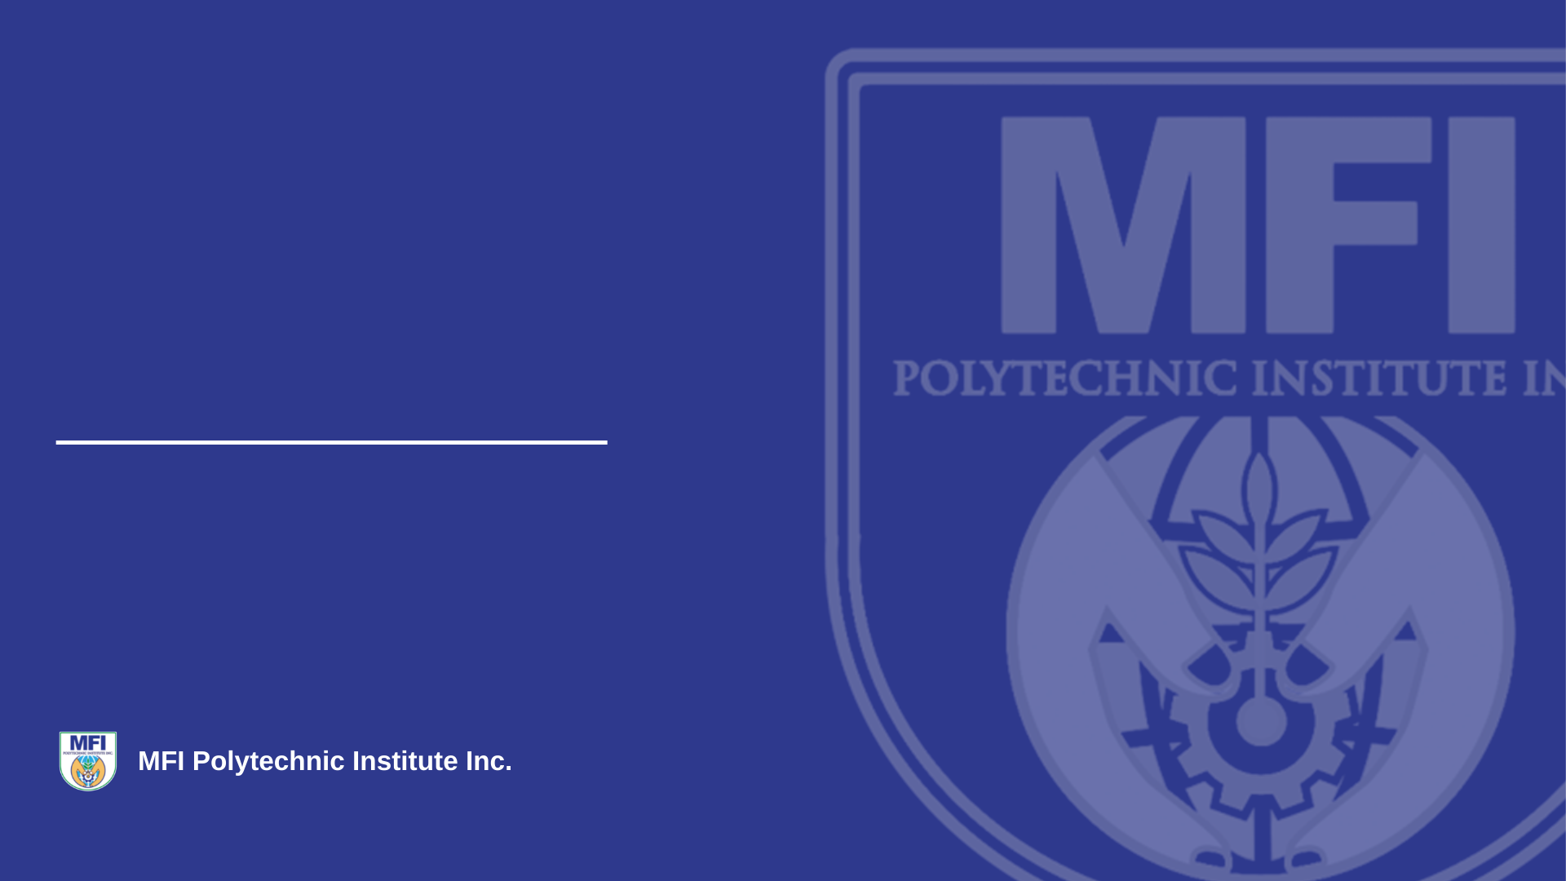
Django REST Framework API Request Lifecycle
Prepared by: Sube, Lhourde Ian R.
Subject: Python Fundamentals
TYDP Information Technology

Slide 3
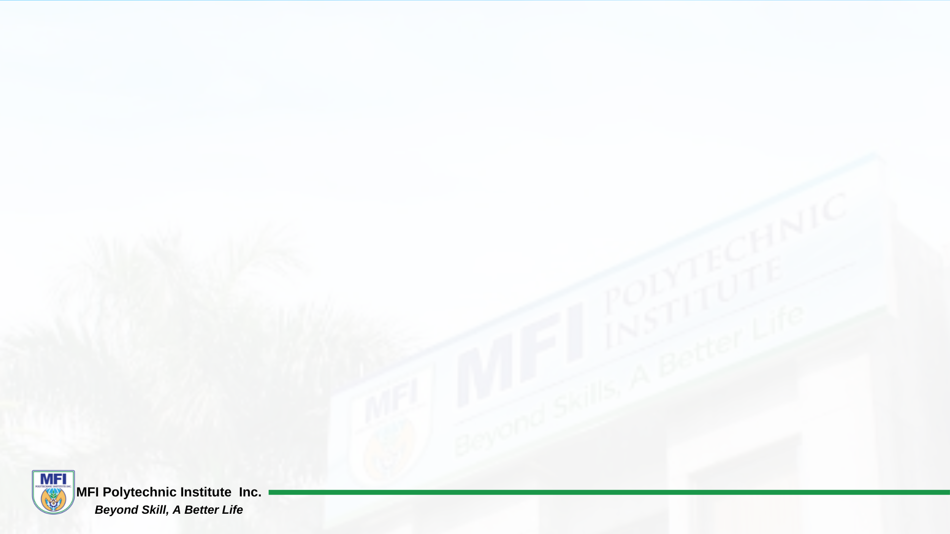
The Roadmap: Request to Response
The big picture, before we zoom in
Client sends an HTTP request
Django middleware runs (auth, sessions, CORS, security...)
URL router matches the request to a view
The view's dispatch() method takes over
DRF authentication and permission checks run
Parsers decode the request body into Python data
The view method routes to create / update / list / destroy
A serializer validates the data, then save() writes to the database
The response is built and flows back out through middleware
Django REST Framework

Slide 4
Stage 1: Entering Django
Before any DRF-specific code runs
Client request
HTTP request arrives
Middleware
Auth, CORS, sessions...
URL router
Matches to a view
View (dispatch)
APIView / ViewSet
Middleware runs top-to-bottom on the way in, and bottom-to-top on the response
Any middleware can short-circuit and return a response early
The URL router matches the request path to a specific view
dispatch() is the entry point DRF adds on top of standard Django views
Stage 1 of 5

Slide 5
What Middleware Actually Does
A chain every request — and response — passes through
SecurityMiddleware — HTTPS redirects, security headers
SessionMiddleware — reads the session cookie, attaches request.session
CommonMiddleware — URL normalization (e.g. trailing slashes)
CsrfViewMiddleware — checks the CSRF token on unsafe methods
AuthenticationMiddleware — attaches request.user from the session
CorsMiddleware — adds CORS headers for cross-origin frontends
Note: Django's AuthenticationMiddleware sets request.user from the session. DRF re-checks auth independently using its own authentication_classes.
Stage 1 of 5

Slide 6
Stage 2: Inside the DRF View
Authentication, parsing, and routing to a method
Auth & permissions
Who is this, what can they do
Parsers
Parses JSON request body
View method
create / update / list / destroy
Serializer
Receives request data
Authentication and permission classes run before any of your view logic
Parsers turn the raw request body into Python data DRF can work with
The view method you wrote (or ModelViewSet provides) receives that data
This is separate from — and runs after — Django's own middleware checks
Stage 2 of 5

Slide 7
Parsers vs. Serializers
Two different jobs that sound alike
Parsers
Serializers
Direction: bytes to Python
Reads the raw request body, decodes it (JSON, form data, multipart)
Runs before your view method sees request.data
Format-aware, not model-aware
Direction: Python to Python/JSON (both ways)
Validates data and maps it to model fields, or a model instance out to JSON
Runs inside your view method, when you instantiate it
Model-aware — knows field types and validation rules
dispatch() vs. the "view method"
dispatch() is fixed framework code — same for every view — that authenticates, checks permissions, then picks a method
The view method (create / update / list / destroy) is the code you write, called once dispatch() finishes its checks
Deep Dive — Stage 2

Slide 8
AuthenticationMiddleware vs. authentication_classes
Two separate systems that both set request.user
Django: AuthenticationMiddleware
DRF: authentication_classes
Runs in the middleware stack, before routing
Identity comes from the Django session (cookie → session store → user)
Sets request.user on the Django HttpRequest
Applies to every request to the app, DRF or not
Runs inside dispatch(), after routing
Identity comes from whatever the authenticator reads (token header, JWT...)
Sets request.user on DRF's Request wrapper, independently
Applies only to views built with DRF
A pure API client with no session cookie can still be fully authenticated in DRF, because TokenAuthentication / JWTAuthentication don't rely on sessions. Middleware answers the identity question first; DRF re-asks it its own way.
Key Distinctions

Slide 9
Stage 3: Serializer to Database
Where validation becomes a saved row
Serializer(data=...)
Wraps incoming data
is_valid()
Field + validate() checks
save()
Calls create() or update()
Database
Row created / updated
is_valid() runs field-level validation, then any validate() method
save() decides whether to call create() or update() based on the instance
create() and update() are the customization points — you (or ModelSerializer) define how data is actually persisted
The serializer never touches the database directly — save() does
Stage 3 of 5

Slide 10
The Three Validation Levels
What is_valid() actually runs, in order
Field-level
e.g. min_value, validators=[...]
validate_<field>()
Custom, single-field logic
validate(self, data)
Runs last — sees all fields
Field-level validators are declarative and run independently per field — they know nothing about other fields
validate_<field_name>() lets you write custom logic for one specific field
validate(self, data) runs only after every field passes individually — the only level that can compare fields (e.g. end_date after start_date)
Any level raising ValidationError stops the chain — is_valid() returns False, save() never runs, errors collect in serializer.errors
Deep Dive — Stage 3

Slide 11
Stage 4: The Way Back
Turning a saved instance into an HTTP response
Database
Returns saved instance
Serializer
Instance to JSON
Renderer
Formats the response
Middleware
Runs in reverse order
The saved model instance is handed back to the serializer
The renderer formats it as JSON (or another content type)
The response passes back up through the same middleware chain, in reverse
The client finally receives the completed HTTP response
Stage 4 of 5

Slide 12
Key Distinctions Worth Remembering
Common points of confusion
Django middleware runs on every request; DRF's auth/permission classes only apply to DRF views
request.user from AuthenticationMiddleware is separate from DRF's own authentication_classes
is_valid() only validates — it never writes to the database
create() and update() are where persistence actually happens, and where you customize it
Notes

Slide 13
The Complete Roadmap
Request in, response out
Client
Sends request
Middleware
In / out
URL router
Matches view
View
dispatch()
Auth / perms
Checks access
Parsers
Decode body
Serializer
is_valid()
save()
create/update
Database
Row written
Response
Back to client
Down: request continues into the serializer layer. Up (not shown): the response retraces this path in reverse through middleware.
Summary

Slide 14
The End!

